Slide 1
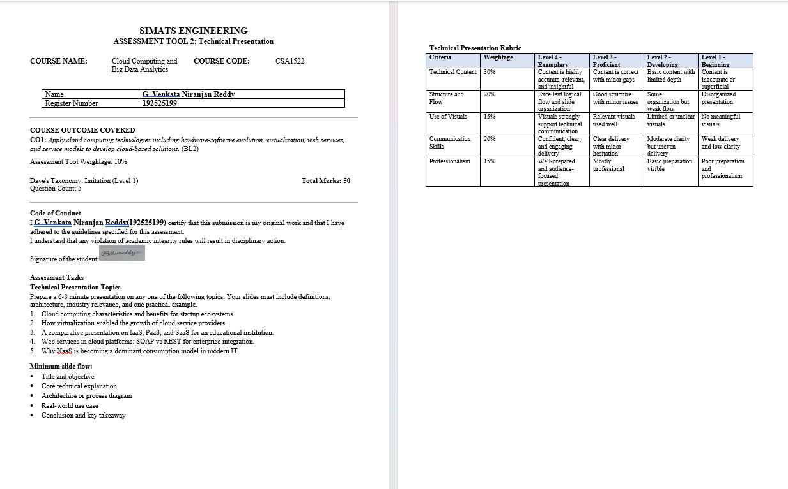

Slide 2
title: Comparative Analysis of IaaS, PaaS, and SaaS for an Educational Institution
CSA1522-Cloud computing & Big Data Analytics
M. Sandeep(192525095)
M. Jaya Kirshna(192524500)
G. Venkata Niranjan Reddy(192525199)
Guided by
RAJARAM PICHAMUTHU

Slide 3
Introduction to Cloud Computing
Cloud computing provides computing resources over the internet.
It reduces the need for institutions to maintain physical IT infrastructure.
Educational institutions can use cloud services for teaching, learning, and administration.
The three major service models are IaaS, PaaS, and SaaS.

Slide 4
IaaS – Infrastructure as a Service
IaaS provides virtualized servers, storage, and networking.
The institution manages the operating system and applications.
It offers high flexibility and control over infrastructure. Resources can be increased or decreased based on demand. Example: Amazon EC2, Microsoft Azure Virtual Machines, Google Compute Engine.

Slide 5
PaaS – Platform as a Service
PaaS provides a ready-made platform for application development.
Developers do not need to manage physical servers.
It includes development tools, databases, and runtime environments.
It allows faster development and deployment of applications.
Examples: Google App Engine, Microsoft Azure App Service, Heroku.

Slide 6
SaaS – Software as a Service
SaaS provides ready-to-use software through the internet.
Users do not need to install or maintain the software. The cloud provider manages the application and infrastructure.
It can be accessed from computers, tablets, and smartphones.
Examples: Google Workspace, Microsoft 365, Zoom

Slide 7
Comparison of IaaS, PaaS, and SaaS
Feature | IaaS | PaaS | SaaS
Provides | Infrastructure | Development Platform | Ready-to-use Software
User Control | High | Medium | Low
Management | IT Team | Developer | Service Provider
Educational Use | Hosting systems | Developing applications | Online learning & collaboration
Example | AWS EC2 | Google App Engine | Google Workspace

Slide 8
Conclusion
IaaS is suitable for institutions needing high infrastructure control.
PaaS is suitable for developing and deploying custom educational applications.
SaaS is ideal for everyday services such as email, online classes, and collaboration.
A combination of all three models can meet different institutional requirements.
Cloud computing improves scalability, flexibility, accessibility, and cost efficiency

Slide 9
Thank you

Slide 10
